Slide 1
ME 6900 Project 3
Jack Kirschler and Tony Tonkovich
Miss-all Industries + Raytheon Lockheed etc LLC​ “Our rockets are accurate, trust us”​
March 28, 2024

Slide 2
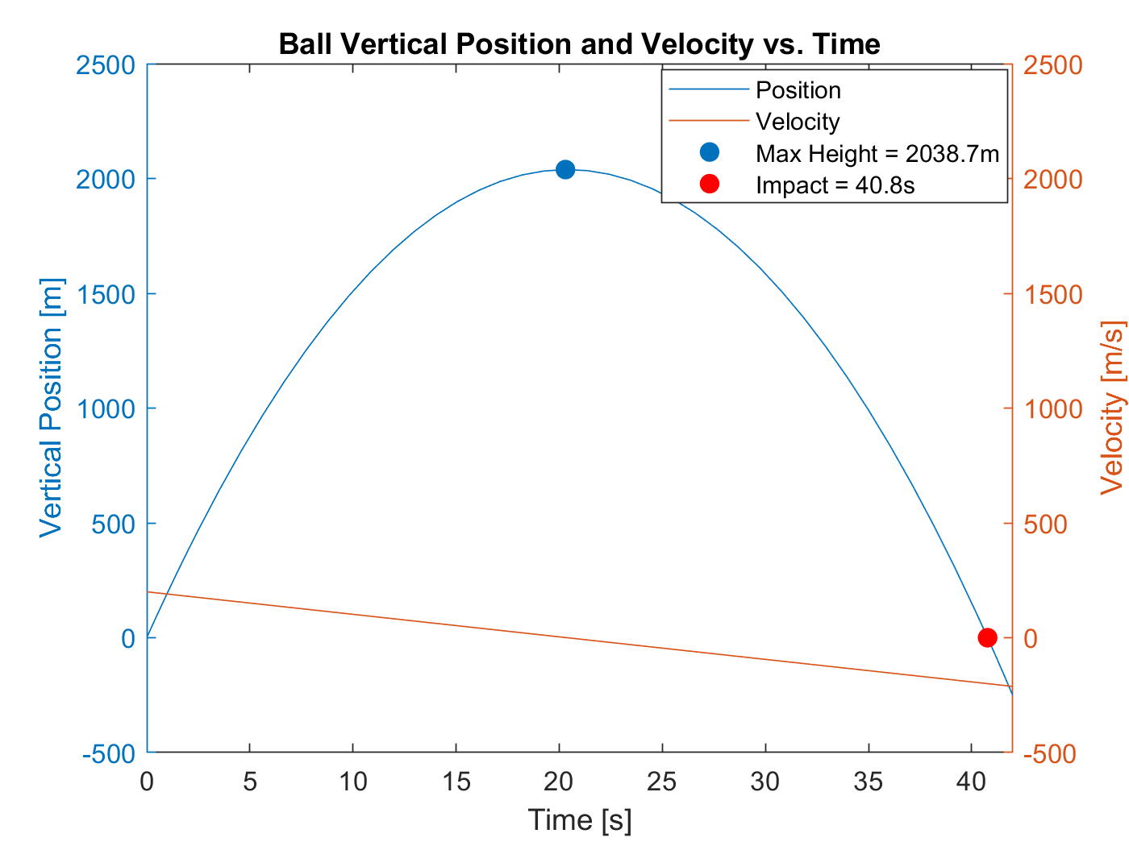
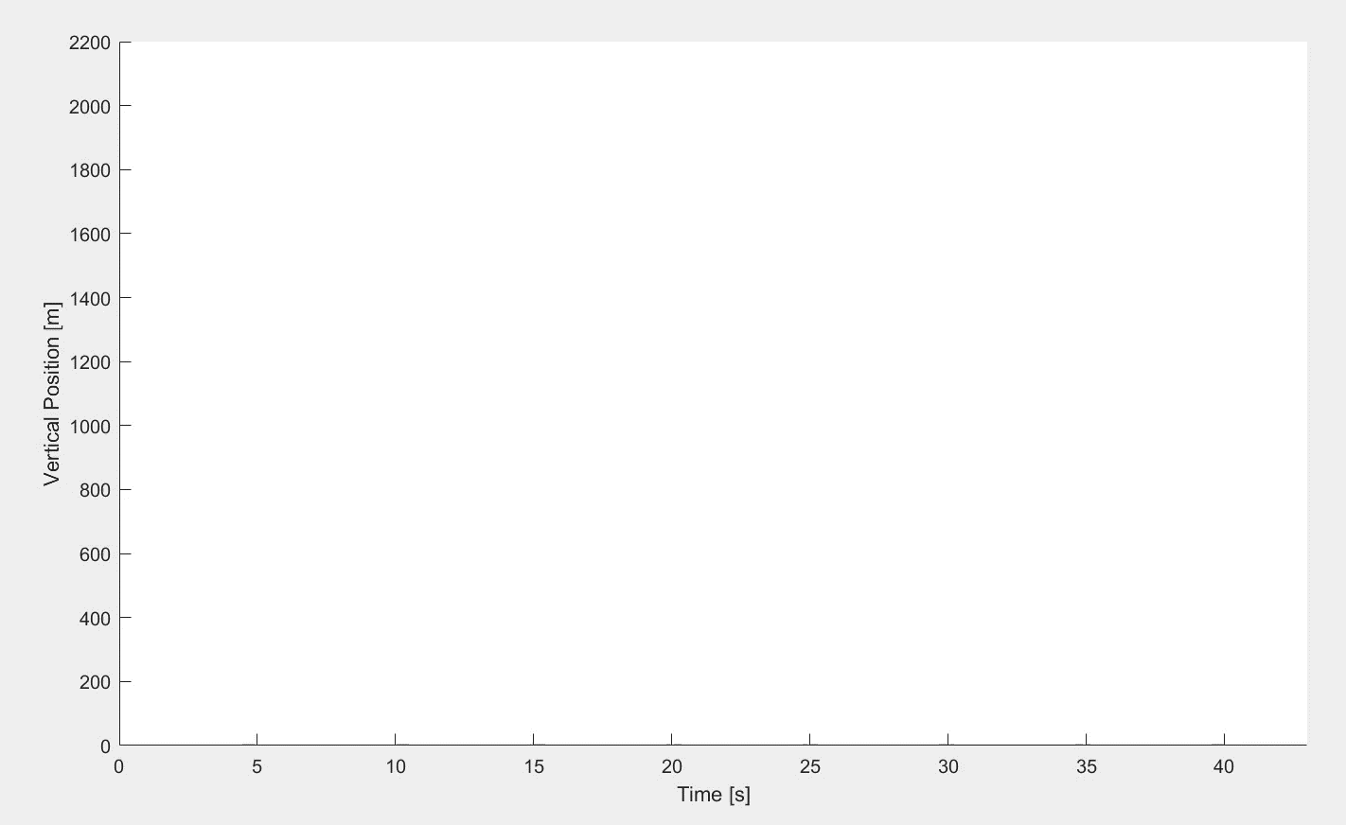
Problem 1: Ball
function dxdt = ode(t,x)
dx = x(2);
dv = -9.81;
dxdt = [dx; dv];
end
Simple Intro into ODE45
Initial Conditions:
H₀ = 0 [m]
V₀ = 200 [m/s]
Derivatives:
da/dt = 0
dv/dt = -9.81 [m/s²]
dh/dt = v [m/s]

Slide 3
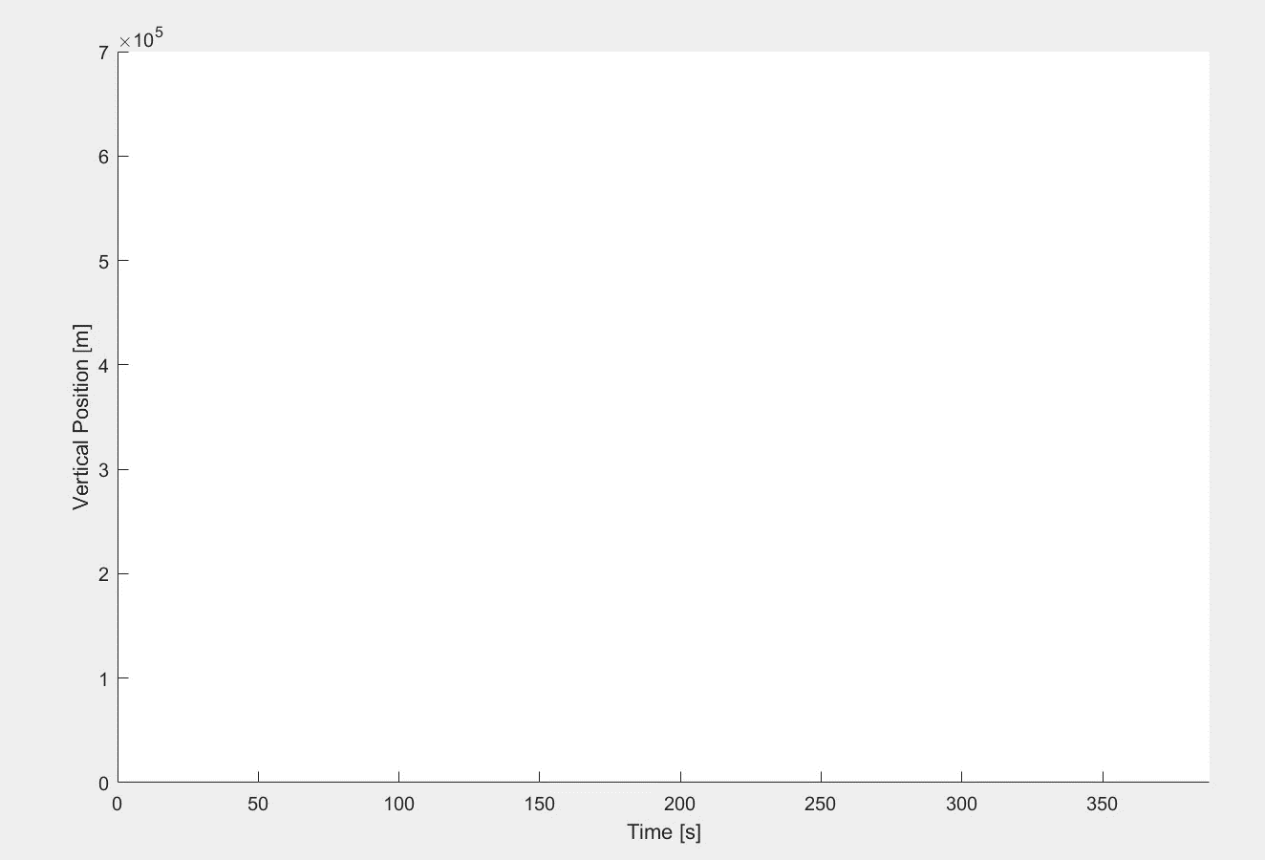
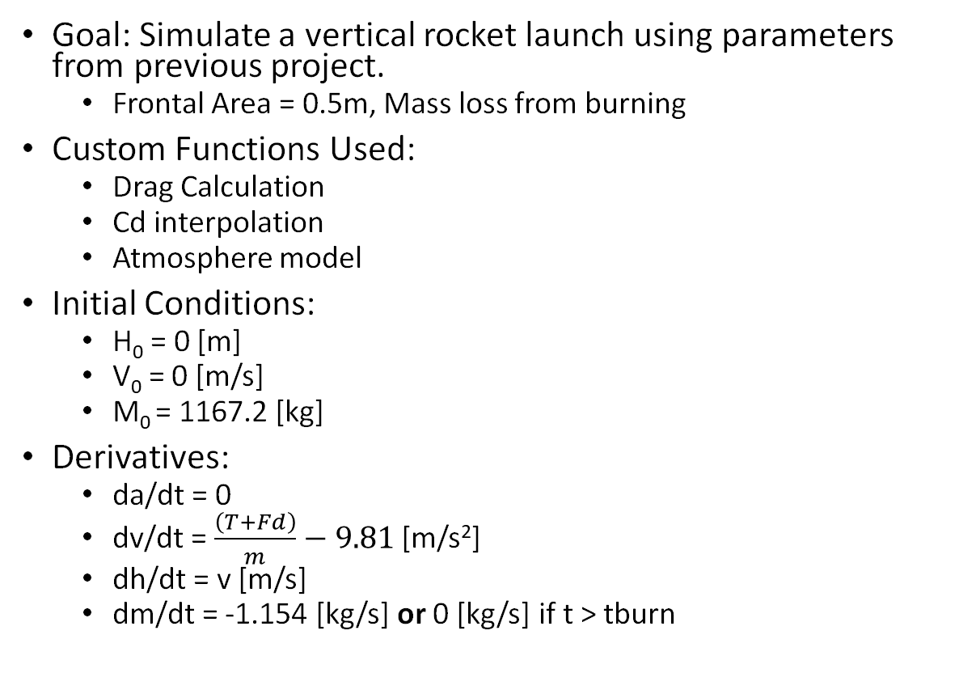
Problem 2: Rocket Launch
function [dxdt, fd, rho, cd, c, T] = flight(t, x, mdot, tBurn)
T = 52000;
A = 0.5;
h = x(1);
v = x(2);
m = x(3);
[rho, c] = atmosmodel(h);
cd = cd_interp(v,c);
fd = drag(rho,v,cd,A);
if t >= tBurn
dm = 0;
T = 0;
else
dm = mdot;
end
dh = x(2);
dv = (T + fd) / m - 9.81;
dxdt = [dh; dv; dm;];
end
Goal: Simulate a vertical rocket launch using parameters from previous project.
Frontal Area = 0.5m, Mass loss from burning
Custom Functions Used:
Drag Calculation
Cd interpolation
Atmosphere model
Initial Conditions:
H₀ = 0 [m]
V₀ = 0 [m/s]
M₀ = 1167.2 [kg]
Derivatives:
da/dt = 0
dv/dt = $\frac{\left(T+Fd\right)}{m}−9.81$ [m/s²]
dh/dt = v [m/s]
dm/dt = -1.154 [kg/s] or 0 [kg/s] if t > tburn

Slide 4
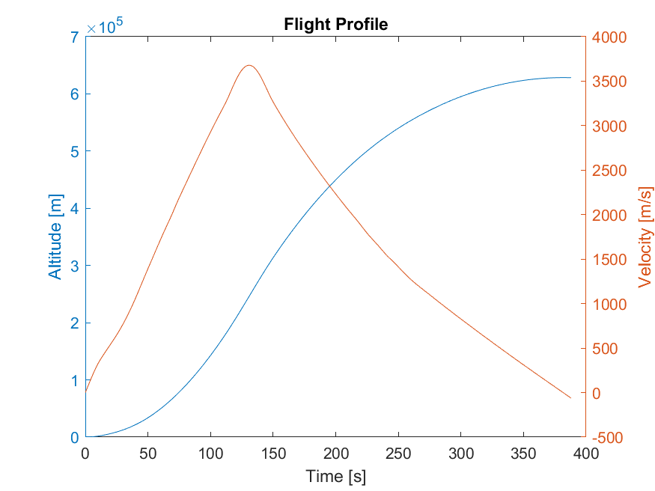
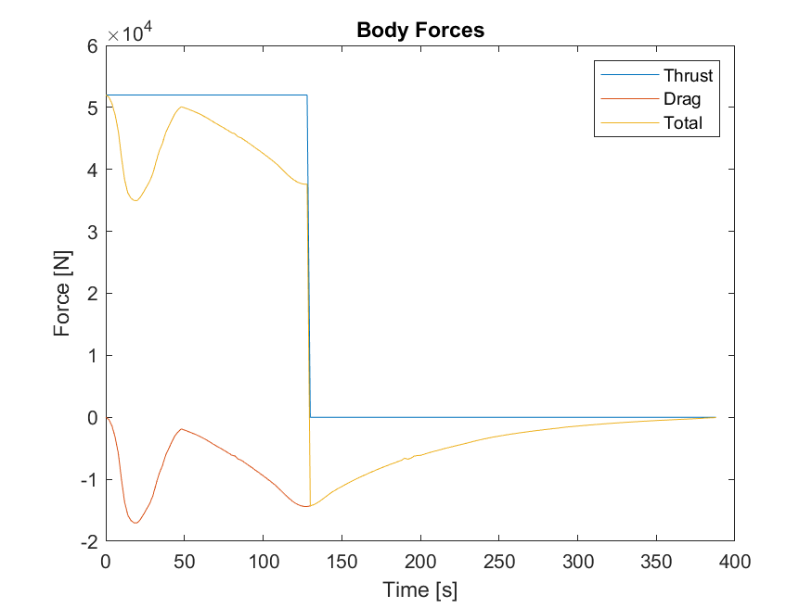
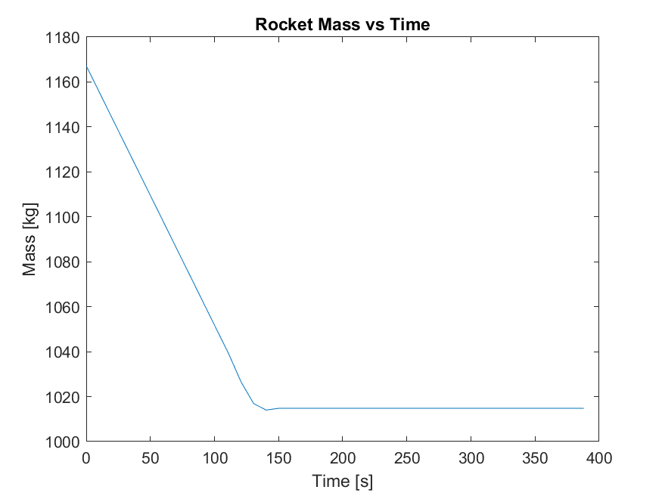
Problem 2: Rocket Launch

Slide 5
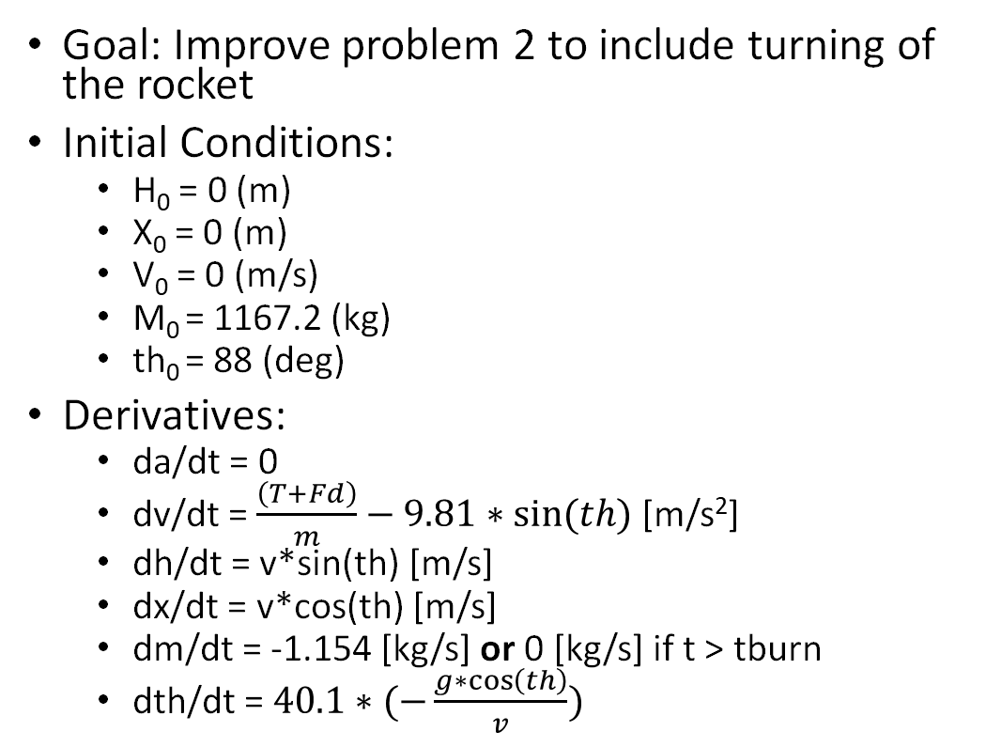
Problem 3: Rocket Launch + Turning
Goal: Improve problem 2 to include turning of the rocket
Initial Conditions:
H₀ = 0 (m)
X₀ = 0 (m)
V₀ = 0 (m/s)
M₀ = 1167.2 (kg)
th₀ = 88 (deg)
Derivatives:
da/dt = 0
dv/dt = $\frac{\left(T+Fd\right)}{m}−9.81∗sin⁡(th)$ [m/s²]
dh/dt = v*sin(th) [m/s]
dx/dt = v*cos(th) [m/s]
dm/dt = -1.154 [kg/s] or 0 [kg/s] if t > tburn
dth/dt = $40.1∗(−\frac{g∗\cos\left(th\right)}{v})$
function [dxdt, fd, rho, cd, c, T] = flight(t, x, mdot, tBurn)
T = 53000;
A = 0.5;
g = 9.81;
m_cst = 40.1;
h = x(1);
v = x(2);
m = x(3);
th = x(5);
[rho, c] = atmosmodel(h);
cd = cd_interp(v,c);
fd = drag(rho,v,cd,A);
if t >= tBurn
dm = 0;
T = 0;
else
dm = mdot;
end
dh = v*sind(th);
dx = v*cosd(th);
dv = (T + fd) / m - g*sind(th);
dth = m_cst*(-(g*cosd(th))/v);
dxdt = [dh; dv; dm; dx; dth;];
end

Slide 6
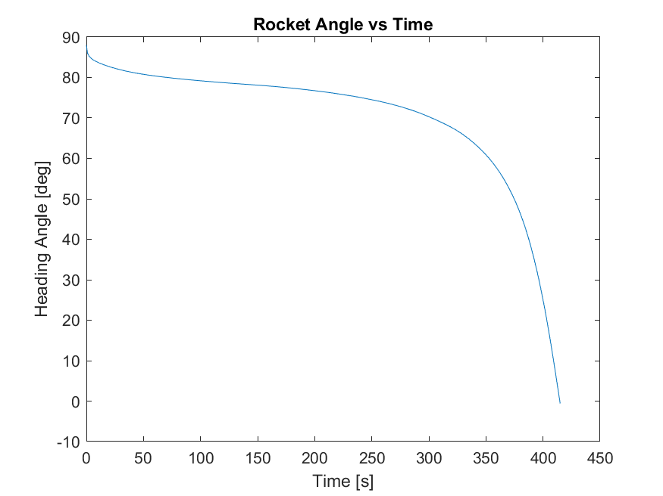
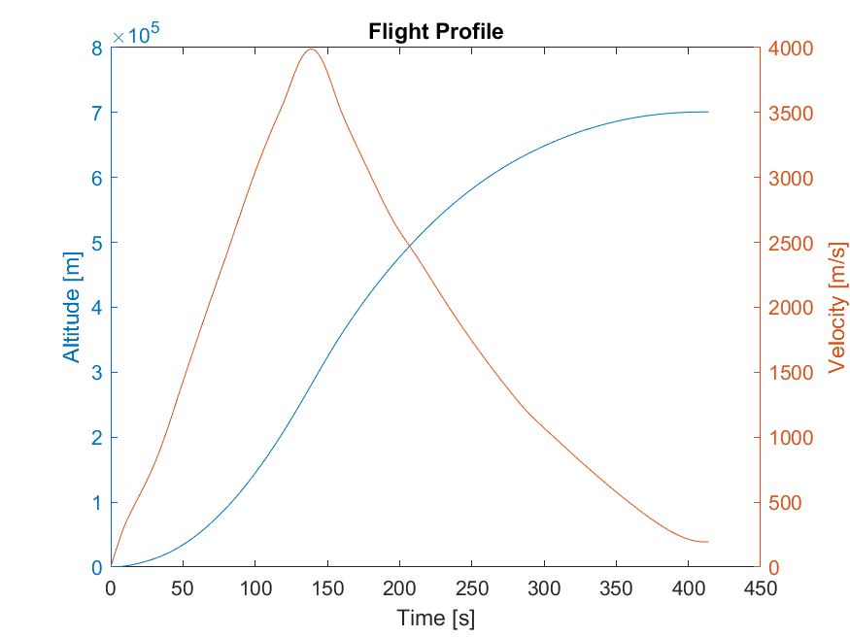
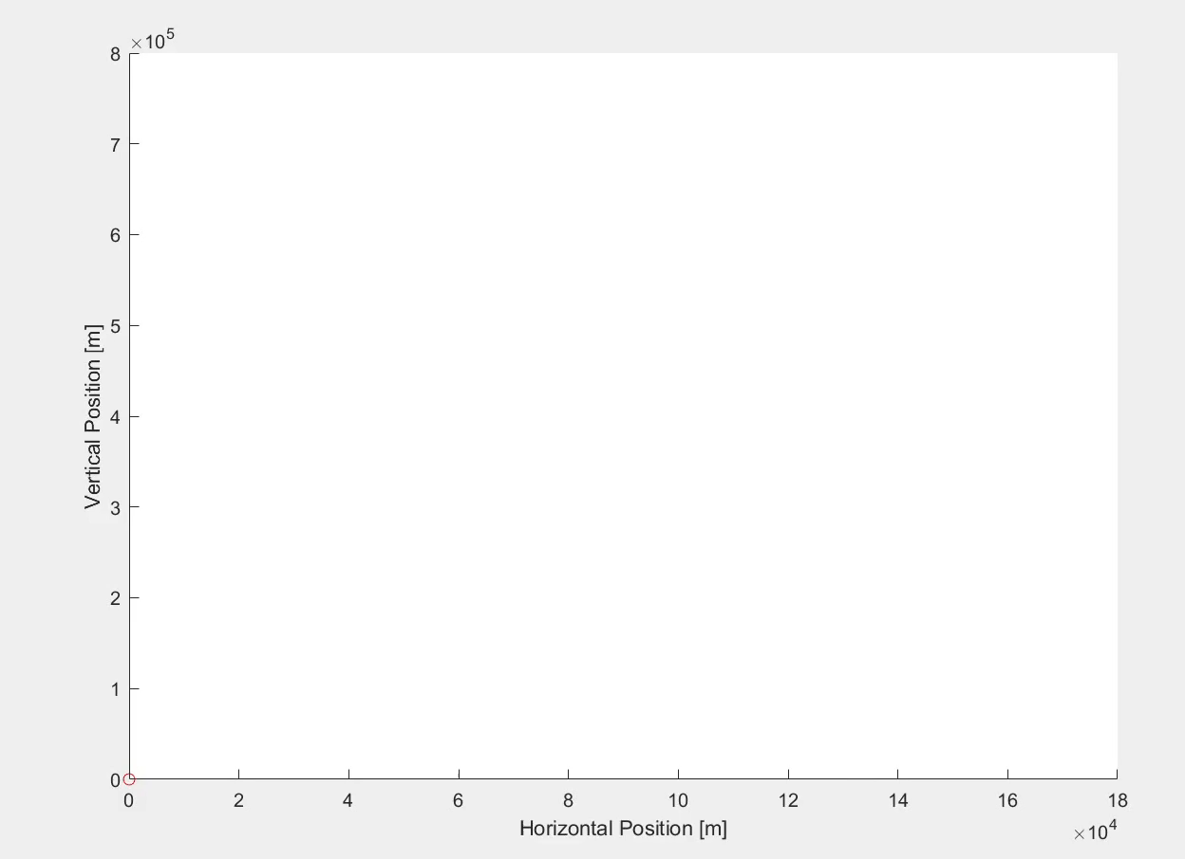
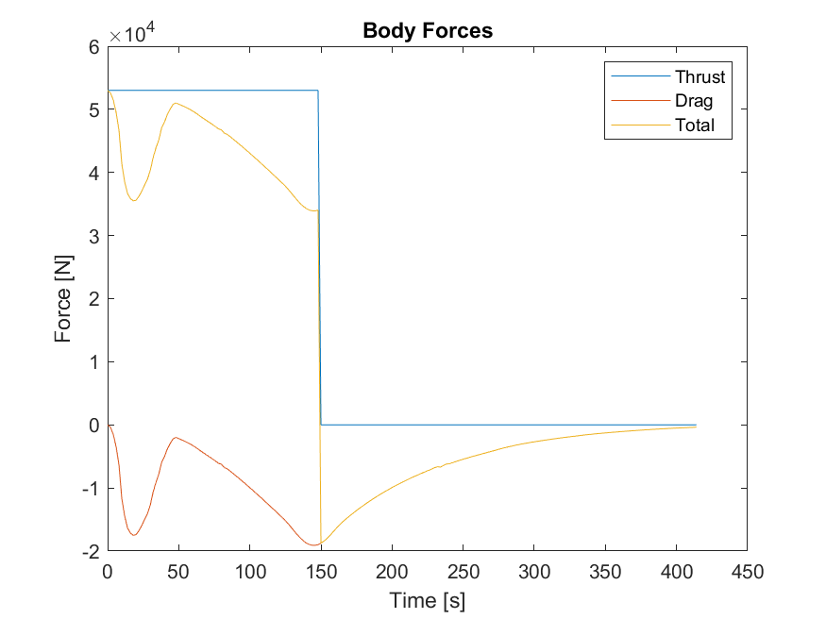
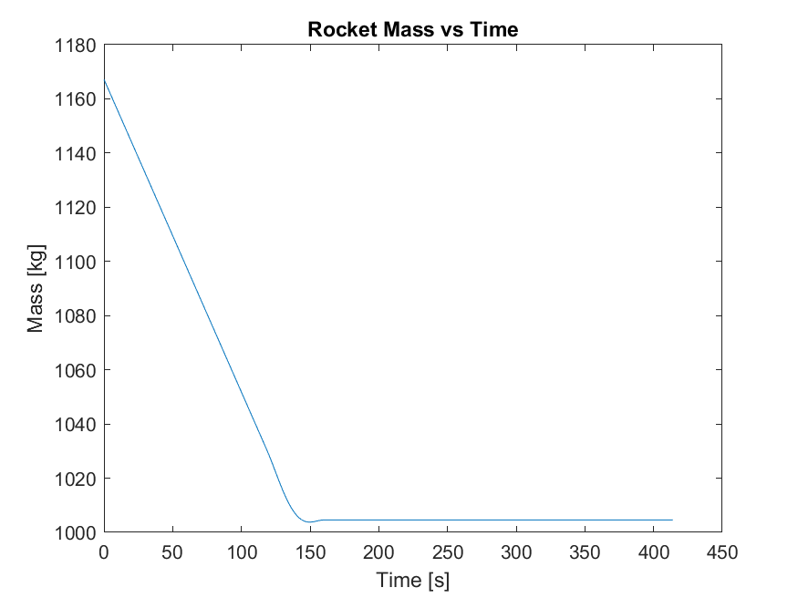
Problem 3: Rocket Launch + Turning

Slide 7
Conclusions
Matched Simulink's 90 degree turn
Overshot altitude due to increased burn time compared to simulink
Pitching delay was not accounted for in ODE45
Parameter | Simulink | ODE45 | Delta
Thrust | 50000 N | 53000 N | +6%
Burn Time | 130 s | 150 s | +15.3%
Moment Constant | 12.35 | 40.1 | +224%

